Slide 1


GPT-Sentinel: Distinguishing Human and ChatGPT Generated Content
Yutian Chen, Hao Kang, Yiyan Zhai

Slide 2
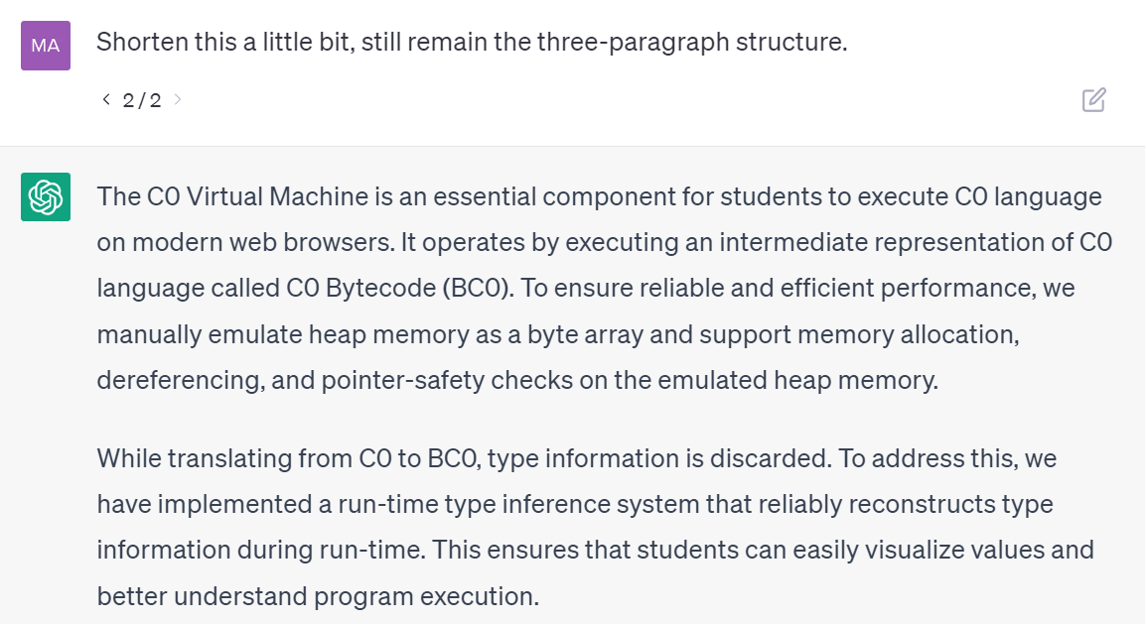
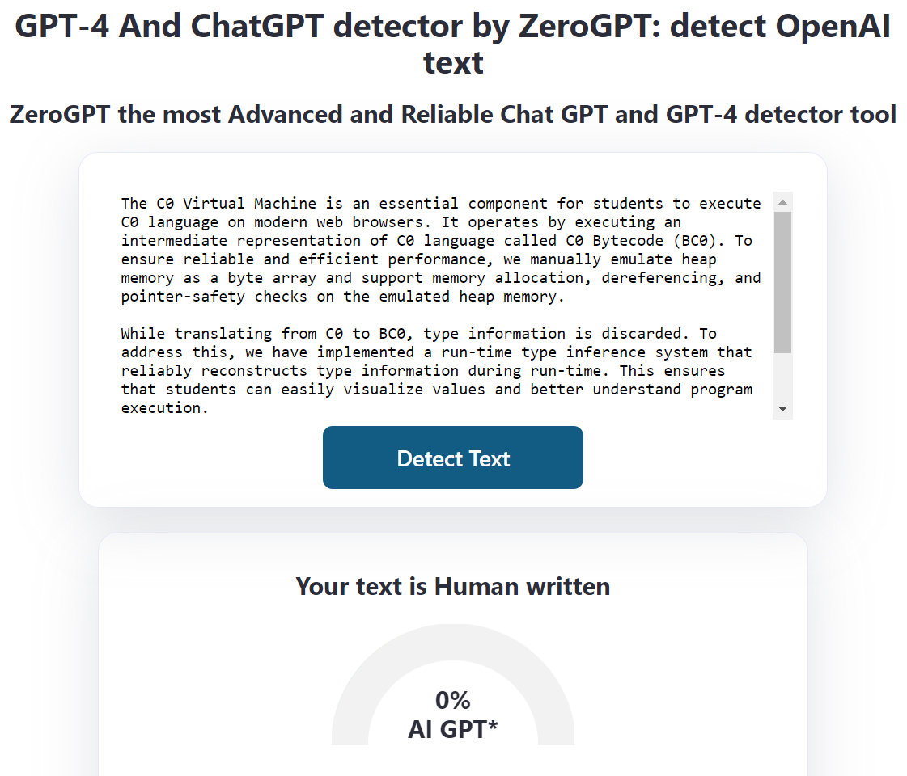
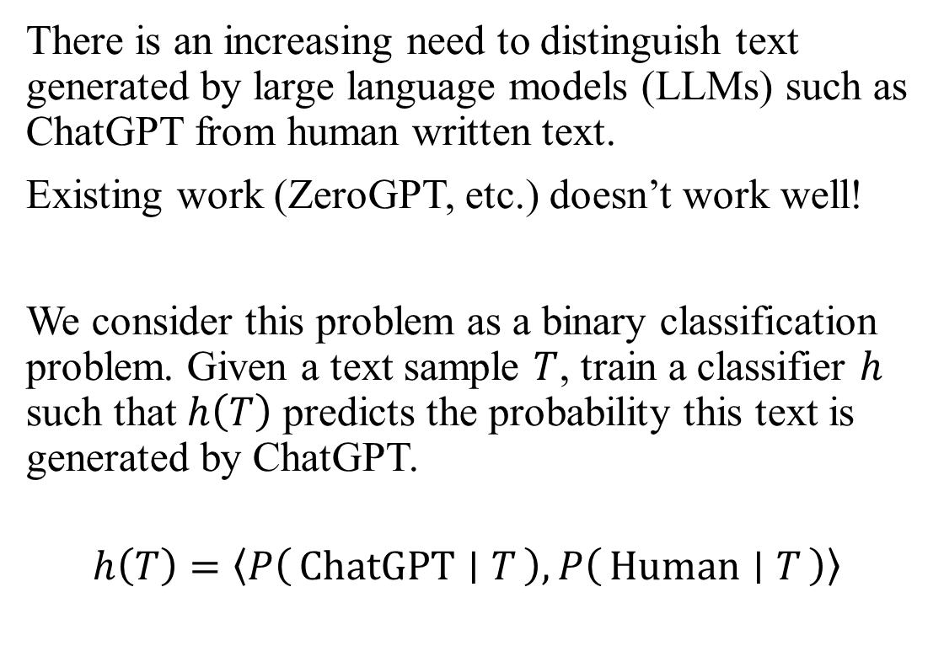
Problem Formulation
There is an increasing need to distinguish text generated by large language models (LLMs) such as ChatGPT from human written text.
Existing work (ZeroGPT, etc.) doesn’t work well!
We consider this problem as a binary classification problem. Given a text sample $T$, train a classifier $h$ such that $h\left(T\right)$ predicts the probability this text is generated by ChatGPT.
$$h\left(T\right)=\left\langle P\left(ChatGPT ∣ T\right), P\left(Human ∣ T\right)\right\rangle$$

Slide 3




Dataset Collection
We collected the data set OpenGPTText - a high-quality data set containing around 30,000 rephrased samples based on OpenWebText.
With unique identifier (UID) corresponding every rephrased text with original corpus.
“Rephrase the following paragraph by paragraph …”
OpenAI API
gpt-3.5-turbo
UID: [urlsf_00]-[00]
(Rephrased)
OpenWebText
UID: [urlsf_00]-[00]
OpenGPTText

Slide 4
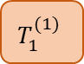
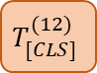
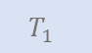
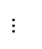
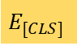
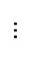
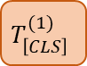
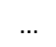

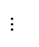
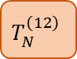
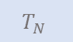
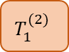
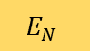
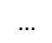
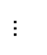
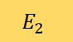
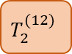
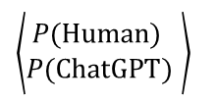
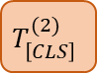
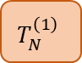
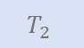
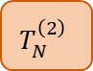
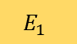
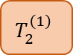
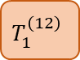
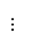
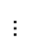
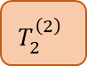
Model Architecture RoBERTa-Sentinel
MLP
RoBERTa-Base
$$T_{[CLS]}$$
$$T_{1}$$
$$T_{2}$$
$$…$$
$$T_{N}$$
$$T_{[CLS]}^{(12)}$$
$$T_{1}^{\left(12\right)}$$
$$T_{2}^{(12)}$$
$$…$$
$$T_{N}^{\left(12\right)}$$
$\left\langle \begin{matrix}P\text{(}Human\text{) } \\ P\text{(}\text{ChatGPT}\text{)} \end{matrix}\right\rangle$
$$…$$
$$…$$
$$…$$
$$…$$
$$T_{\left[CLS\right]}^{(2)}$$
$$T_{1}^{(2)}$$
$$T_{2}^{\left(2\right)}$$
$$…$$
$$T_{N}^{\left(2\right)}$$
$$…$$
$$…$$
$$T_{\left[CLS\right]}^{(1)}$$
$$T_{1}^{(1)}$$
$$T_{2}^{\left(1\right)}$$
$$…$$
$$T_{N}^{\left(1\right)}$$
768
768
$$E_{[CLS]}$$
$$E_{1}$$
$$E_{2}$$
$$…$$
$$E_{N}$$
This
is
$$…$$
GPT

Slide 5
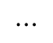
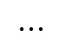
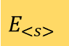
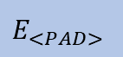
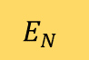
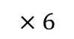
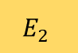
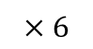
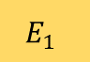
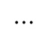
Model Architecture T5-Sentinel
$$\left\langle P\left(\text{ChatGPT}\right)= , P\left(Human\right)= \right\rangle$$
“Positive”
“Negative”
Next-word
Probability Distribution
$$⋯$$
T5 Decoder Block
$$×6$$
Feed Forward
T5 Encoder Block
Masked Multi-head Attention
Feed-forward MLP
$$×6$$
$$⋯$$
Self-Attention
Masked Multi-head Attention
$$E_{1}$$
$$E_{2}$$
$$⋯$$
$$E_{N}$$
$$E_{<s>}$$
$$E_{<PAD>}$$

Slide 6
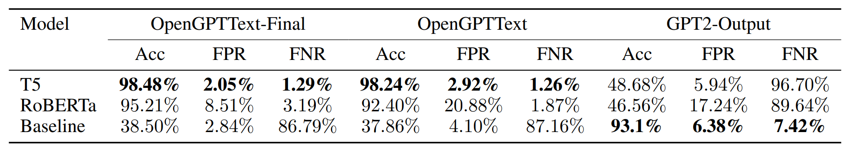
Model Evaluation
T5 model (version 2) outperforms the RoBERTa model (version 1)
Reached accuracy of 98.48% on test data set.
*We also includes the Receiver Operating Condition (ROC), Decision Error Trade-off (DET) and Area Under Curve (AUC) statistics in our final report.

Slide 7
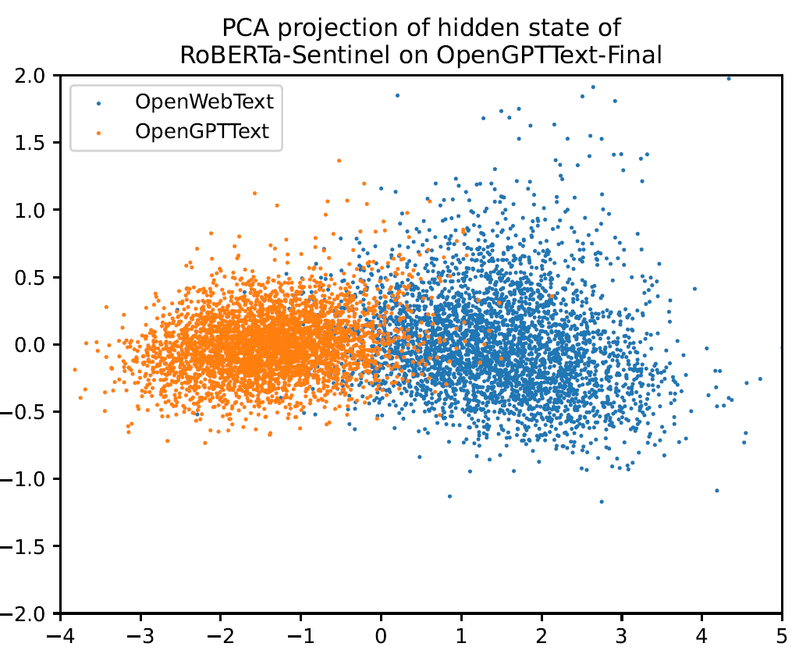
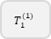
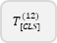
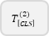
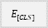
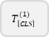
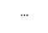
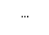
















Interpretability Study
We ran principal component analysis (PCA) on hidden states MLP in RoBERTa. Result indicate that our model successfully learned the “rephrasing feature” in text input.
MLP
RoBERTa-Base
$$T_{[CLS]}$$
$$T_{1}$$
$$T_{2}$$
$$…$$
$$T_{N}$$
$$T_{[CLS]}^{(12)}$$
$$T_{1}^{\left(12\right)}$$
$$T_{2}^{(12)}$$
$$…$$
$$T_{N}^{\left(12\right)}$$
$$…$$
$$…$$
$$…$$
$$…$$
$$T_{\left[CLS\right]}^{(2)}$$
$$T_{1}^{(2)}$$
$$T_{2}^{\left(2\right)}$$
$$…$$
$$T_{N}^{\left(2\right)}$$
$$…$$
$$…$$
$$T_{\left[CLS\right]}^{(1)}$$
$$T_{1}^{(1)}$$
$$T_{2}^{\left(1\right)}$$
$$…$$
$$T_{N}^{\left(1\right)}$$
768
768
$$E_{[CLS]}$$
$$E_{1}$$
$$E_{2}$$
$$…$$
$$E_{N}$$
This
is
$$…$$
GPT

Slide 8








Interpretability Study
For T5-small model, we ran PCA on last hidden state of T5-Decoder. Resulting image indicate that Human and Generated text are better separated in T5 than in RoBERTa.
Last Hidden State of Decoder
T5 Decoder Block
Feed Forward
$$×6$$
T5 Encoder Block
Masked Multi-head Attention
Feed-forward MLP
$$×6$$
$$⋯$$
Self-Attention
Masked Multi-head Attention
$$E_{1}$$
$$E_{2}$$
$$⋯$$
$$E_{N}$$
$$E_{<s>}$$
$$E_{<PAD>}$$

Slide 9











Interpretability Study
We use the gradient integral method to study which part of the text is considered more “GPT-like” by T5-Sentinel.
Label = “Human”
T5 Decoder Block
Feed Forward
$$×6$$
T5 Encoder Block
Masked Multi-head Attention
Feed-forward MLP
$$×6$$
$$⋯$$
Self-Attention
Masked Multi-head Attention
$$E_{1}$$
$$E_{2}$$
$$⋯$$
$$E_{N}$$
$$E_{<s>}$$
$$E_{<PAD>}$$
$$∇_{L}Tok_{1}$$
$$∇_{L}Tok_{1}$$
$$⋯$$
$$∇_{L}Tok_{N}$$

Slide 10
Conclusion
We collect and published a high-quality rephrasing data set with gpt-3.5-turbo called OpenGPTText.
We design, implement and trained two architectures for text classification using BERT and T5 as backbone, respectively.
The model shows State Of The Art (SOTA) performance on test data set, reaching accuracy of 98%+.
Interpretability study show that the model can extract features related with Human/Generated text.

